Slide 1
POM
2025

Slide 2
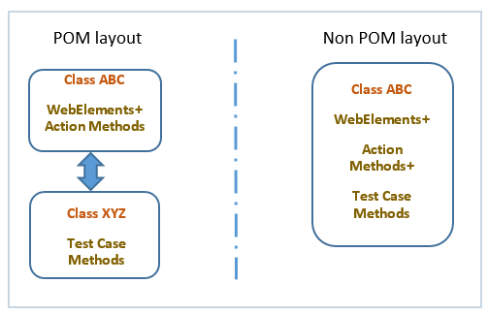
POM
The Page Object Model (POM) is a design pattern widely used in test automation, particularly with Selenium, to enhance the maintainability, scalability, and reusability of automated test scripts.
It advocates for a structured approach to organizing code by representing each web page or significant component of a web application as a separate class. Each class contains locators for the web elements on that page and methods that define how to interact with these elements (like clicking a button or entering text).

Slide 3
POM
Page as a Class: Each distinct page or major section of the application's user interface is represented as a separate class. For example, a login page would have a LoginPage class, a dashboard page would have a DashboardPage class, and so on.
Element Locators within Page Classes: Web element locators (e.g., By.id, By.xpath, By.cssSelector) for elements on a specific page are encapsulated within its corresponding page class. This centralizes the management of element locators.
By txt_username_loc=By.xpath("//input[@id=userID']");
Methods for Page Interactions: Each page class contains methods that represent the actions or operations a user can perform on that page. These methods interact with the web elements defined within the same class. For example, a LoginPage class might have methods like enterUsername(), enterPassword(), and clickLoginButton().
Test class: The test class contains the actual test logic and assertions. It uses the methods from the page classes to perform actions on the UI elements but does not contain any locators or direct WebDriver calls for finding elements.

Slide 4
Advantages of POM
Improved Maintainability: If a UI element's locator changes, only the corresponding page object needs to be updated, not every test script that uses that element.
Reduced Code Duplication: Element locators and common interaction methods are defined once in the page object and can be reused across multiple test cases.
Enhanced Readability: Test scripts become more readable and easier to understand as they use descriptive method names from page objects, abstracting away the underlying Selenium WebDriver commands.
Increased Reusability: Page objects can be reused across different test suites and frameworks, promoting modularity.
Better Test Scalability: As the application grows, adding new pages or features can be managed by creating new page objects without significantly impacting existing tests.

Slide 5
PAGE FACTORY
Page Factory is a class in Selenium that makes it easier to implement the Page Object Model.
It reduces the amount of boilerplate code required to create Page Objects, making the code cleaner and easier to maintain.
It uses annotations (@FindBy) to define locators, instead of writing By objects manually.
It automatically initializes elements when the page class is created, using the initElements() method
It can be implemented in 2 steps:-
Step1:
Using the @FindBy annotation - Unlike the regular approach of initializing web page elements using FindElement or FindElements, the Page Factory uses the @FindBy annotation. It provides the following syntax to locate the web elements:
@FindBy(xpath="//input[@placeholder='Username']")
WebElement txt_username;

Slide 6
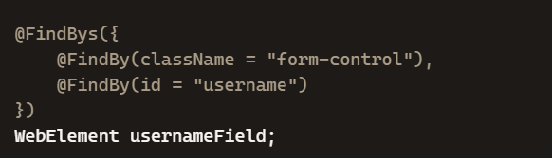
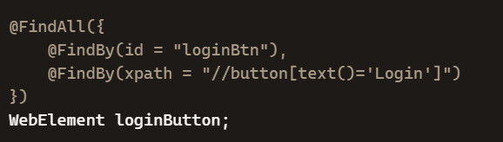
PAGE FACTORY
Step2:
Initializing the elements using initElements() - This is a static method used to initialize the web elements that we locate using the @FindBy or other annotation(s), thereby instantiating the page class.
PageFactory.initElements(driver, this);
@FindBys (AND condition)
Used when you want to locate an element by
combining multiple locators.
2. @FindAll (OR condition)
Used when you want to locate an element that can be
identified by any one of multiple locators.

Slide 7
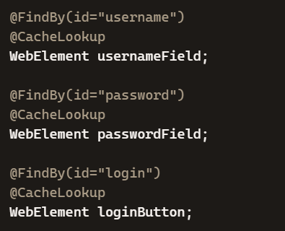
PAGE FACTORY
@CacheLookup
It’s an annotation in Selenium’s Page Factory that tells WebDriver to cache the WebElement once it’s located.
Normally, every time you call element.click() or element.sendKeys(), Selenium re-finds the element in the DOM.
With @CacheLookup, Selenium stores the element in memory after the first lookup, so subsequent calls don’t search the DOM again.

Slide 8
Extent Reporting
Extent Reports is a popular open-source library used with Selenium to generate detailed, interactive, and customizable HTML reports for test automation results. While native testing frameworks like TestNG and JUnit provide basic reports, Extent Reports offer a superior, visually appealing, and detailed summary that is easier for all stakeholders to understand.
Key features
Rich dashboard: Provides a comprehensive overview of test execution, including pie charts showing the pass/fail/skip percentages.
Detailed test steps: Logs each step of a test case with a clear status (Pass, Fail, Skip, Info).
Screenshot support: Allows the capture and embedding of screenshots, particularly useful for failed test cases to aid in debugging.
Customization: Offers extensive options to customize the report's theme (light/dark), layout, title, and other details.
Categorization: Tags and organizes tests into categories (e.g., 'Regression', 'Smoke') for easier filtering and analysis.
Integration: Integrates seamlessly with popular testing frameworks like TestNG and JUnit, and with Continuous Integration (CI/CD) tools like Jenkins.

Slide 9
Extent Reporting
Core classes for generating reports
To generate an Extent Report in a Selenium-based project (commonly using Java), you interact with the following key classes:
ExtentSparkReporter: This class creates and configures the HTML report file. You specify the output file path and can apply custom configurations like the report title and theme.
ExtentReports: This is the main class for managing the report. You attach the ExtentSparkReporter to this class and use it to create new test entries.
ExtentTest: This class represents a test case. You create an ExtentTest instance for each test method and use it to log events, status, and information throughout the test execution

